Slide 1

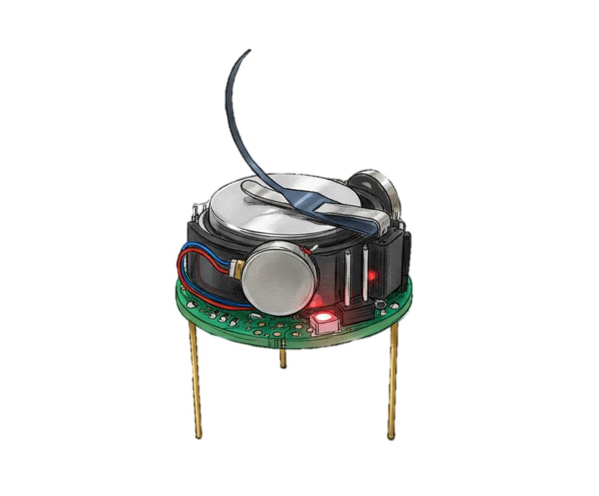
Shape formation
using Kilobots

Slide 2
Shape formation
using Kilobots

Slide 3
Shape formation
using Kilobots

Slide 4
Shape formation
using Kilobots

Slide 7
Motion
Communication

Slide 8
Motion

Slide 11
Communication

Slide 14
Star Planet
Orbit

Slide 15
Star Planet
Orbit

Slide 16
Star Planet
Orbit

Slide 17
Star Planet
Orbit

Slide 18
Multi-Star Planet
Orbit

Slide 19
Guide
Builder

Slide 22
3
1.41
1
1
2
1

Slide 23
3
1
2

Slide 24
1st Neighbor Distance
2nd Neighbor Distance
1st Neighbor
2nd Neighbor
Builder
4 2 1 3 1
5 2 1 4 1.41
6 4 1 5 1

Slide 25
2
1

Slide 26
1st Neighbor Distance
2nd Neighbor Distance
1st Neighbor
2nd Neighbor
Builder
4 2 1 3 1
5 2 1 4 1.41
6 4 1 5 1

Slide 27
1st Neighbor Distance
2nd Neighbor Distance
1st Neighbor
2nd Neighbor
Builder
4 2 1 3 1

Slide 28
1
3
4
1
1
2

Slide 29
1st Neighbor Distance
2nd Neighbor Distance
1st Neighbor
2nd Neighbor
Builder
4 2 1 3 1
5 2 1 4 1.41

Slide 30
3
4
1.41
1
2
5
1

Slide 31
1st Neighbor Distance
2nd Neighbor Distance
1st Neighbor
2nd Neighbor
Builder
4 2 1 3 1
5 2 1 4 1.41
6 4 1 5 1

Slide 32
1
3
4
6
1
1
2
5

Slide 34
3
4
6
1
2
5

Slide 35
3
4
4
1
2

Slide 36
3
4
1
2
5
5

Slide 37
3
4
6
6
1
2
5

Slide 39
Y
Estimate
(x, y)
(0, 1)
X
(0, 0)
(1, 0)

Slide 40

$ε−margin$

